Slide 1
Java
Week1-Day-1

Slide 2
Table of Contents
01
04
Introduction to Java8
JDK, JRE, JVM
Hello Java,
Class and Objects
Pillars of OOPS
Package and import
Constructors
Methods and Parameter
Access Specifier
Non Access Specifier

Slide 3
01
Installation of Java
https://www.java.com/en/download/help/download_options.html
https://www.oracle.com/java/technologies/javase-downloads.html#JDK16

Slide 4
Environment Setup
Download JDk: http://www.oracle.com/technetwork/java/javase/downloads/index.html
Setup Path:
Temporary: in CMD, set path=copied_path ( C:\Program Files\Java\jdk1.8.0_23\bin)
Permanent: Computer Properties|Advanced|System Properties|Enviornment Variables|New}Mention pah
Install Eclipse Kepler for Java Projects

Slide 5
01
Introduction to Java

Slide 6
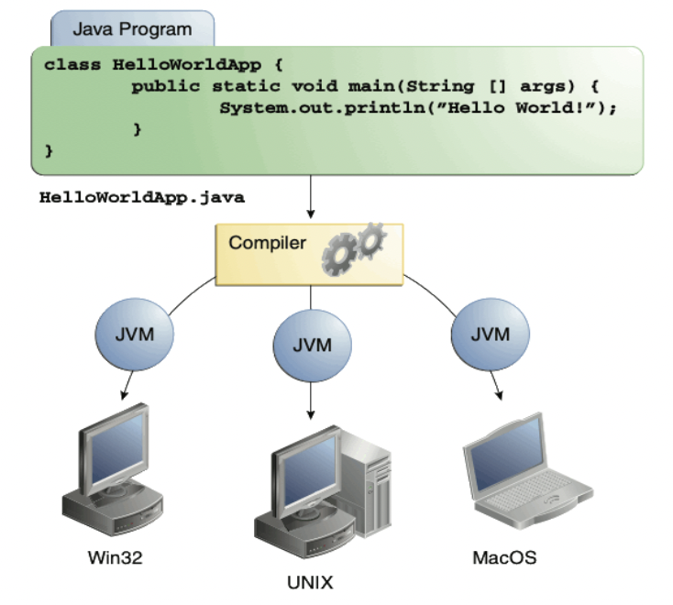
What is Java
Java is high level technology
Secure
Object Oriented
Distributed
Multithreaded
Architecture neutral
Portable
High performance
Robust
Secure

Slide 7
Java Platform
The Java platform has two components:
The Java Virtual Machine
The Java Application Programming Interface (API)

Slide 8
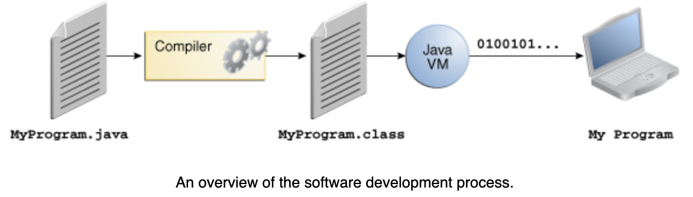
JVM Java Virtual Machine
A Virtual Machine is a software implementation of a physical machine.
JVM (Java Virtual Machine) is an abstract machine that enables your computer to run a Java program.
Java was developed with the concept of WORA (Write Once Run Anywhere), which runs on a VM.

Slide 9
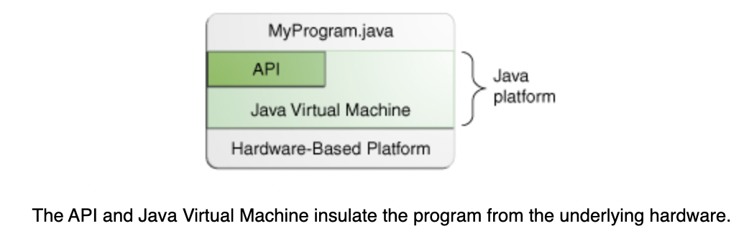
JVM Java Virtual Machine
The Java platform has two components:
The Java Virtual Machine
The Java Application Programming Interface (API)

Slide 10
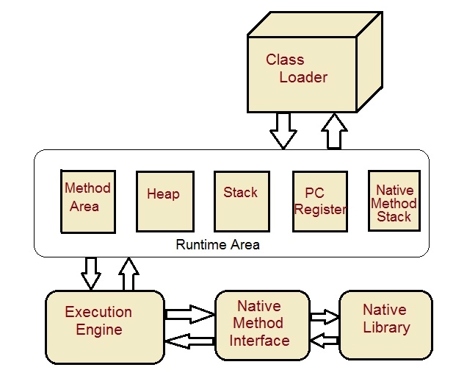
JVM Architecture
Class Loader : Class loader loads the Class for execution.
Method area : Stores pre-class structure as constant pool.
Heap : Heap is a memory area in which objects are allocated.
Stack : Local variables and partial results are store here. Each thread has a private JVM stack created when the thread is created.
Program register : Program register holds the address of JVM instruction currently being executed.
Native method stack : It contains all native used in application.
Executive Engine : Execution engine controls the execute of instructions contained in the methods of the classes.
Native Method Interface : Native method interface gives an interface between java code and native code during execution.
Native Method Libraries : Native Libraries consist of files required for the execution of native code.

Slide 11
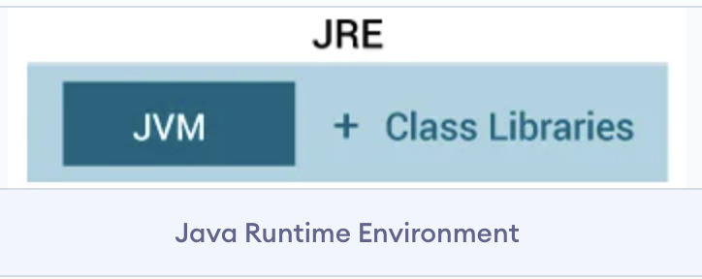
JRE
The Java Runtime Environment (JRE) provides the libraries, the Java Virtual Machine, and other components to run applets and applications written in the Java programming language. JRE does not contain tools and utilities such as compilers or debuggers for developing applets and applications.

Slide 12
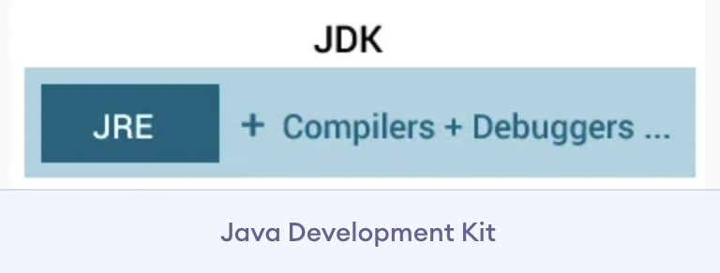
JDK
JDK (Java Development Kit) is a software development kit required to develop applications in Java. When you download JDK, JRE is also downloaded with it.

Slide 13
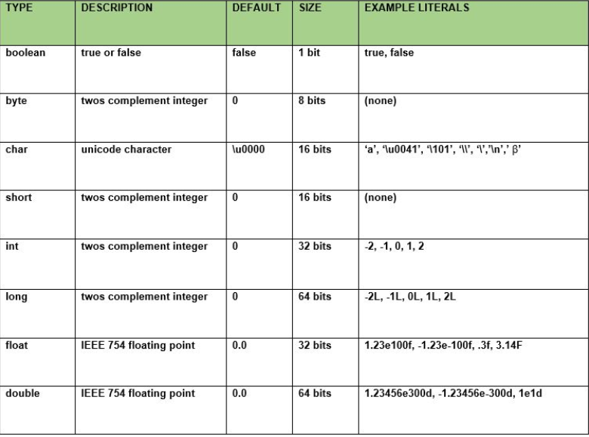
Primitive Data Type
Notes:
https://docs.oracle.com/javase/tutorial/java/nutsandbolts/datatypes.html

Slide 14
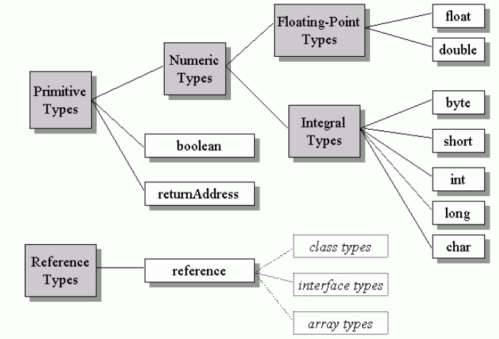
Data Type

Slide 15
Primitive – Floating-Point
float :
It is 4 bytes(32-bits) float data type.
Default value 0.0f. example: float ff=10.3f;
Double :
It is 8 bytes(64-bits) float data type.
Default value 0.0d. example: double db=11.123;

Slide 16
Primitive - Char
Char –
It is 2 bytes(16-bits) unsigned unicode character.
Range 0 to 65,535. example: char c='a';

Slide 17
Primitive- Boolean
This group represent boolean, which is a special type for representing true/false values.
They are defined constant of the language.
example: boolean b=true;

Slide 18
Class and Object

Slide 19
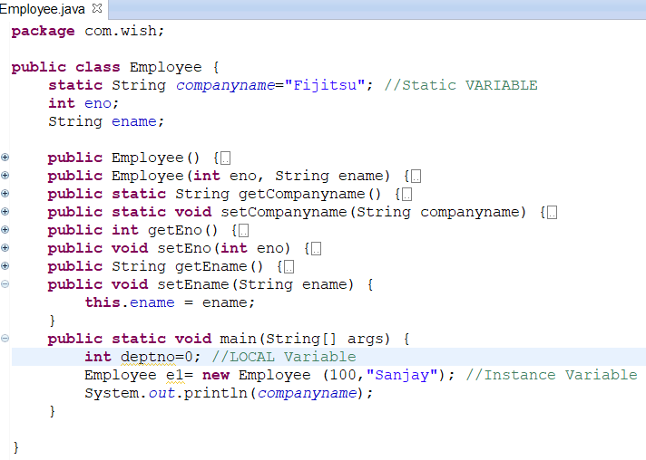
Variable
Local Variable
Instance Variable
Static

Slide 20
Operators
Arithmetic Operators
Relational Operators
Bitwise Operators
Logical Operators
Assignment Operators
Misc Operators

Slide 21
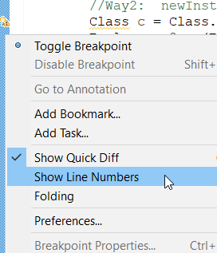
Tip: Line number

Slide 22
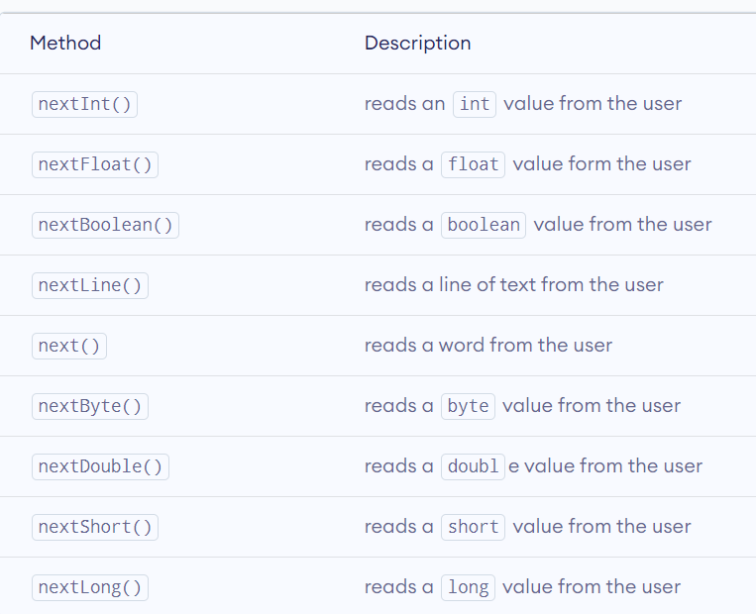
Scanner

Slide 23
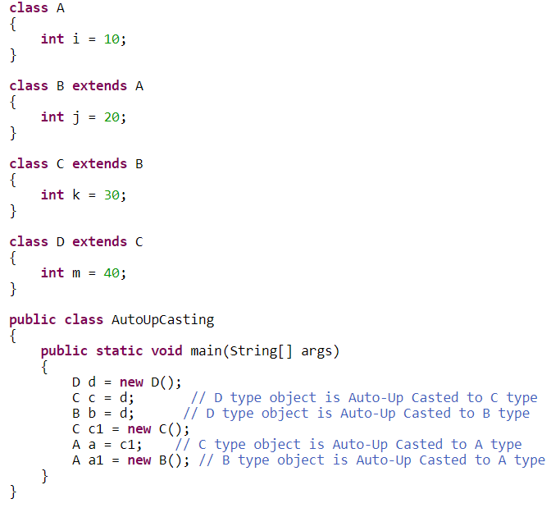
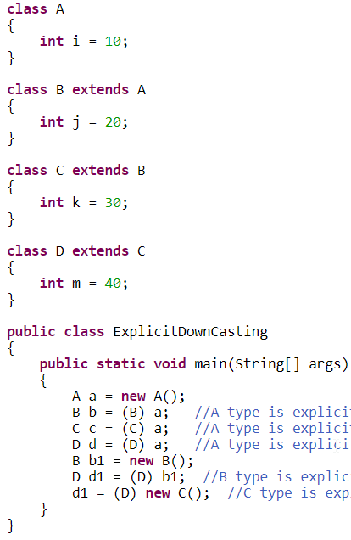
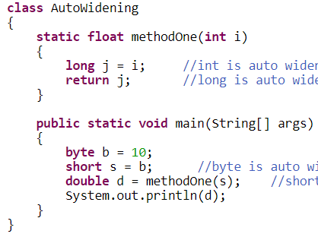
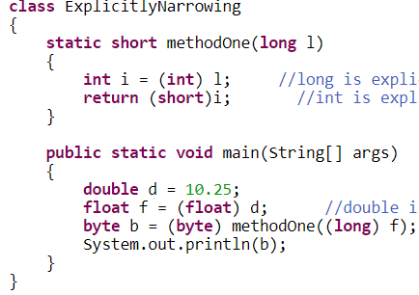
Type Casting
Primitive Casting
convert data from one primitive data type to another primitive data type.
byte < short < int < long < float < double.
Derived Casting
change the type of object from one user defined data type to another user defined data type in the class hierarchy
AUTOWIDING
When target data type is larger than source data type.
Narrowing
When target datatype is smaller than source data type.
AutoUp
object from sub class type to super class type.
Down Casting
Convert an object of super class type to an object of sub class type.

Slide 24
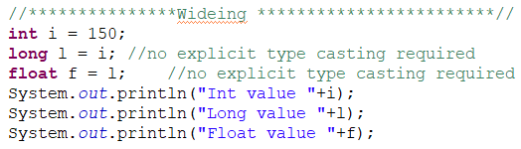
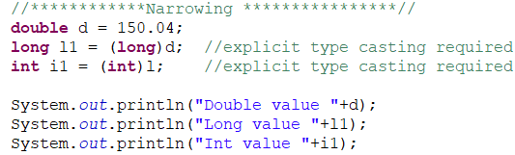
Type Casting
Wideing
Narrowing
When target data type is larger than source data type.
When target datatype is smaller than source data type.

Slide 25
Operators
Arithmetic Operators
Relational Operators
Bitwise Operators
Logical Operators
Assignment Operators
Misc Operators

Slide 26
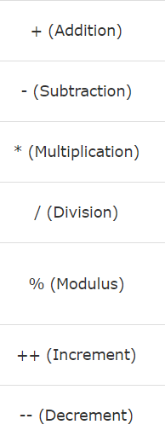
Operator - Arthmatic

Slide 27
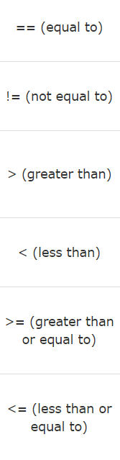
Operator - Relation

Slide 28
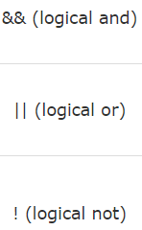
Logical Operator

Slide 29
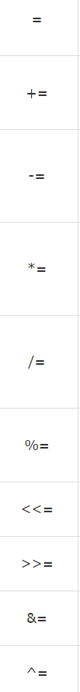
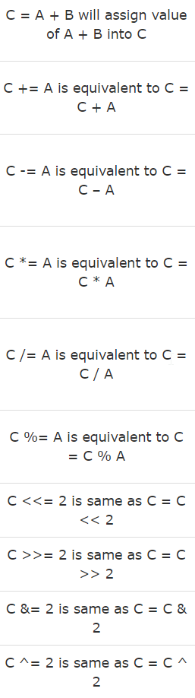
Operator -Assignment

Slide 30
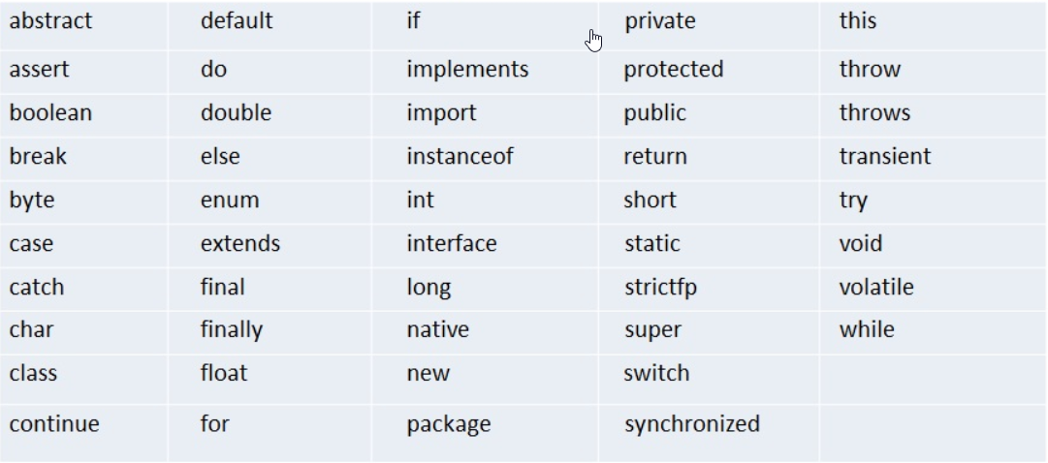
Keywords

Slide 31
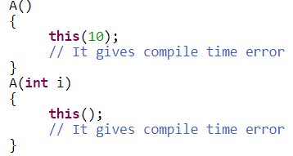
Constructor
Constructor value at the time of object creation.
Compiler automatically creates - Default constructor
Constructors must not have a return type.
Constructor can be declared as private.
Only public, protected and private keywords are allowed before a constructor name.

Slide 32
Type of Constructor
NoArg Constructor
Parameter Constructor
Default

Slide 33
‘this’ key word
To refer current class fields (instance variables).
To refer current class constructor(implicitly).
To refer the current class method.
To pass object as an argument to method.
To pass object as an argument to constructor.
To return object from a method

Slide 34
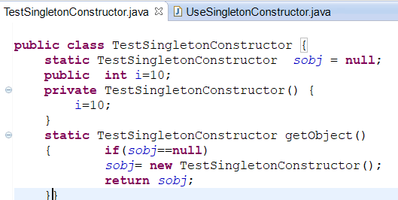
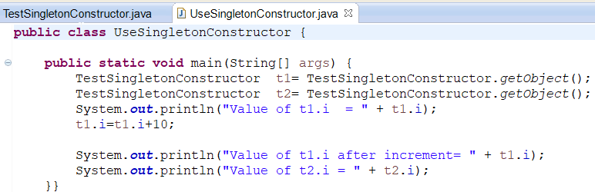
Brainstorm: Purpose of Private constructor
Internal Constructor chaining
Singleton class design pattern
Can super class constructor call sub class constructor ?

Slide 35
Access Specifier
The access specifiers also determine which data members (methods or fields) of a class can be accessed by other data members of classes or packages etc.
To ensure encapsulation and reusability, these access specifiers/modifiers are an integral part of object-oriented programming.
Types:
#1) Access Modifiers
Access modifiers in Java allow us to set the scope or accessibility or visibility of a data member be it a field, constructor, class, or method.
#2) Non-access Modifiers
Java also provides non-access specifiers that are used with classes, variables, methods, constructors, etc. The non-access specifiers/modifiers define the behavior of the entities to the JVM.
static
final
abstract
transient
volatile
synchronized
native

Slide 36
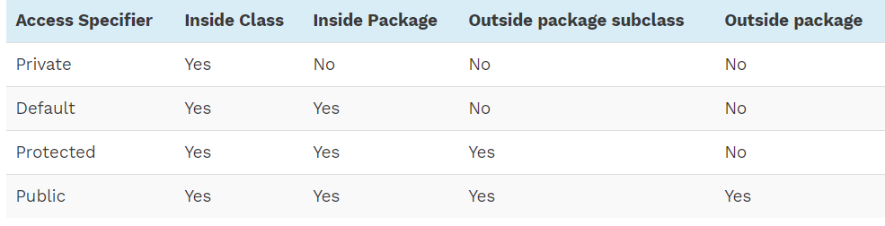
Access Specifier
#1) Default: Whenever a specific access level is not specified, then it is assumed to be ‘default’. The scope of the default level is within the package.
#2) Public: This is the most common access level and whenever the public access specifier is used with an entity, that particular entity is accessible throughout from within or outside the class, within or outside the package, etc.
#3) Protected: The protected access level has a scope that is within the package. A protected entity is also accessible outside the package through inherited class or child class.
#4) Private: When an entity is private, then this entity cannot be accessed outside the class. A private entity can only be accessible from within the class.

Slide 37
Access Specifier

Slide 38
Non Access Specifier
Final
Static
Transient
Synchronized
Volatile

Slide 39
Final
A final is a keyword that can be applied with outer class, inner class, variable, and method. It cannot be applied with interface, constructor, block, and enum.
A final class cannot be extended
A final method cannot be overridden in java.
Once a final variable is declared and initialized, it cannot be changed.

Slide 40
Non Access Specifier - Static Block
Static block executes before the main method while executing program.
When we have multiple static blocks then each block executes in the sequence.

Slide 41
Non Access Specifier - Initializer Block
The initializer Block is used to initialize instance data members.
The initializer block is executed whenever an object is created. The Initializer block is copied into Java compiler and then to every constructor.

Slide 42
Non Access Specifier - Volatile
1. A volatile modifier can be applied only with variables. It is a keyword.
2. If a data member or variable is declared as volatile, all threads can see consistent the value of variable in java memory.
3. A volatile keyword cannot be applied with a method declaration.
4. Volatile does not create any kind of lock on the variable in the program.
Hope that this tutorial has covered almost all important points related to non-access modifiers in java. I hope that you will have understood the basic idea of non-access modifiers and enjoyed it.

Slide 43
Non Access Specifier - Transient
When an instance variable is declared as transient, then its value doesn't persist when an object is serialized

Slide 44
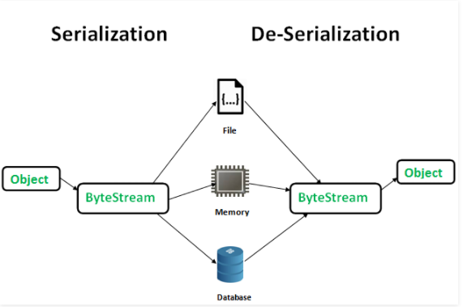
Serialization
Serialization is a mechanism of converting the state of an object into a byte stream. Deserialization is the reverse process where the byte stream is used to recreate the actual Java object in memory. This mechanism is used to persist the object.
To make a Java object serializable we implement the java.io.Serializable interface.

Slide 45
Advantages of Serialization
To save/persist state of an object.
To travel an object across a network.
Note:
Only non-static data members are saved via Serialization process.
Static data members and transient data members are not saved via Serialization process.So, if you don’t want to save value of a non-static data member then make it transient.

Slide 46
Non Access Specifier
Final
Final modifier can be used with variable, method and class. if variable is declared final then we cannot change its value. If method is declared final then it can not be overridden and if a class is declared final then we can not inherit it.
Static
static modifier is used to make field static. We can use it to declare static variable, method, class etc. static can be use to declare class level variable. If a method is declared static then we don’t need to have object to access that. We can use static to create nested class.
Transient
When an instance variable is declared as transient, then its value doesn't persist when an object is serialized
Synchronized
When a method is synchronized it can be accessed by only one thread at a time. We will discuss it in detail in Thread.
Volatile
Volatile modifier tells to the compiler that the volatile variable can be changed unexpectedly by other parts of a program. Volatile variables are used in case of multi-threading program.

Slide 47
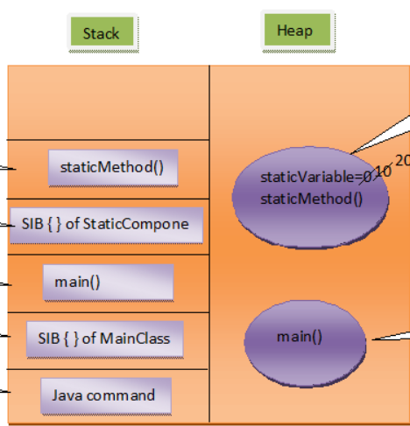
Static Member
Static Block
Static Initialization Block is used to initialize only static variables.
Block without name.
SIBs are not stored in the heap memory. They just come to stack, execute their tasks and leaves the memory
Static Variable
Static Method

Slide 48
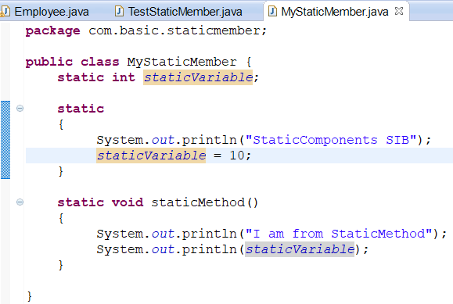
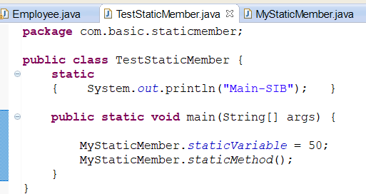
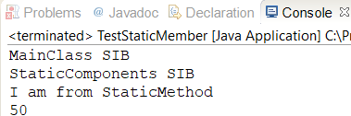
Static Member

Slide 49
Annotation
Annotations, a form of metadata, provide data about a program that is not part of the program itself. Annotations have no direct effect on the operation of the code they annotate.
Annotations have a number of uses, among them:
Information for the compiler — Annotations can be used by the compiler to detect errors or suppress warnings.
Compile-time and deployment-time processing — Software tools can process annotation information to generate code, XML files, and so forth.
Runtime processing — Some annotations are available to be examined at runtime.
@Author(name = "Jane Doe") @Author(name = "John Smith")

Slide 50
Garbage Collection
Whenever you run a java program, JVM creates three threads:
1) main thread 2) Thread Scheduler 3) Garbage Collector Thread.
In these three threads, main thread is a user thread and remaining two are daemon threads which run in background.
The task of main thread is to execute the main() method. The task of thread scheduler is to schedule the threads. The task of garbage collector thread is to sweep out abandoned objects from the heap memory. Abandoned objects or dead objects are those objects which does not have live references. Garbage collector thread before sweeping out an abandoned object, it calls finalize() method of that object. After finalize() method is executed, object is destroyed from the memory. That means clean up operations which you have kept in the finalize() method are executed before an object is destroyed from the memory.
Garbage collector thread does not come to heap memory whenever an object becomes abandoned. It comes once in a while to the heap memory and at that time if it sees any abandoned objects, it sweeps out those objects after calling finalize() method on them. Garbage collector thread calls finalize() method only once for one object.

Slide 51
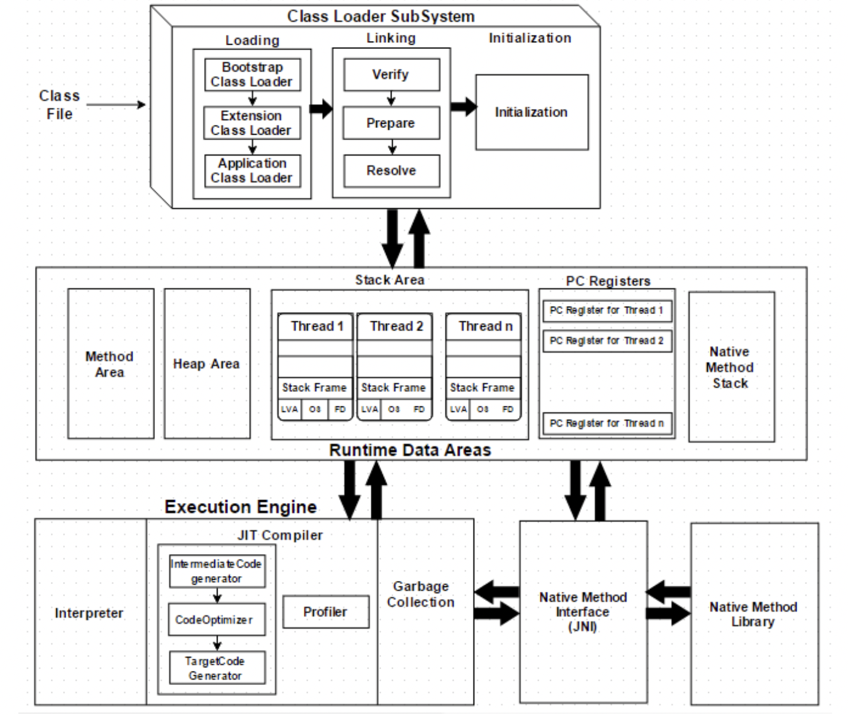
JVM Architecture
Notes:
How Does the JVM Work?
As shown in the above architecture diagram, the JVM is divided into three main subsystems:
ClassLoader Subsystem
Runtime Data Area
Execution Engine
1. ClassLoader Subsystem
Java's dynamic class loading functionality is handled by the ClassLoader subsystem. It loads, links. and initializes the class file when it refers to a class for the first time at runtime, not compile time.
1.1 Loading
Classes will be loaded by this component. BootStrap ClassLoader, Extension ClassLoader, and Application ClassLoader are the three ClassLoaders that will help in achieving it.
BootStrap ClassLoader – Responsible for loading classes from the bootstrap classpath, nothing but rt.jar. Highest priority will be given to this loader.
Extension ClassLoader – Responsible for loading classes which are inside the ext folder (jre\lib).
Application ClassLoader –Responsible for loading Application Level Classpath, path mentioned Environment Variable, etc.
The above ClassLoaders will follow Delegation Hierarchy Algorithm while loading the class files.
1.2 Linking
Verify – Bytecode verifier will verify whether the generated bytecode is proper or not if verification fails we will get the verification error.
Prepare – For all static variables memory will be allocated and assigned with default values.
Resolve – All symbolic memory references are replaced with the original references from Method Area.
1.3 Initialization
This is the final phase of ClassLoading; here, all static variables will be assigned with the original values, and the static block will be executed.
2. Runtime Data Area
The Runtime Data Area is divided into five major components:
Method Area – All the class-level data will be stored here, including static variables. There is only one method area per JVM, and it is a shared resource.
Heap Area – All the Objects and their corresponding instance variables and arrays will be stored here. There is also one Heap Area per JVM. Since the Method and Heap areas share memory for multiple threads, the data stored is not thread-safe.
Stack Area – For every thread, a separate runtime stack will be created. For every method call, one entry will be made in the stack memory which is called Stack Frame. All local variables will be created in the stack memory. The stack area is thread-safe since it is not a shared resource. The Stack Frame is divided into three subentities:
Local Variable Array – Related to the method how many local variables are involved and the corresponding values will be stored here.
Operand stack – If any intermediate operation is required to perform, operand stack acts as runtime workspace to perform the operation.
Frame data – All symbols corresponding to the method is stored here. In the case of any exception, the catch block information will be maintained in the frame data.
PC Registers – Each thread will have separate PC Registers, to hold the address of current executing instruction once the instruction is executed the PC register will be updated with the next instruction.
Native Method stacks – Native Method Stack holds native method information. For every thread, a separate native method stack will be created.
3. Execution Engine
The bytecode, which is assigned to the Runtime Data Area, will be executed by the Execution Engine. The Execution Engine reads the bytecode and executes it piece by piece.
Interpreter – The interpreter interprets the bytecode faster but executes slowly. The disadvantage of the interpreter is that when one method is called multiple times, every time a new interpretation is required.
JIT Compiler – The JIT Compiler neutralizes the disadvantage of the interpreter. The Execution Engine will be using the help of the interpreter in converting byte code, but when it finds repeated code it uses the JIT compiler, which compiles the entire bytecode and changes it to native code. This native code will be used directly for repeated method calls, which improve the performance of the system.
Intermediate Code Generator – Produces intermediate code
Code Optimizer – Responsible for optimizing the intermediate code generated above
Target Code Generator – Responsible for Generating Machine Code or Native Code
Profiler – A special component, responsible for finding hotspots, i.e. whether the method is called multiple times or not.
Garbage Collector: Collects and removes unreferenced objects. Garbage Collection can be triggered by calling System.gc(), but the execution is not guaranteed. Garbage collection of the JVM collects the objects that are created.
Java Native Interface (JNI): JNI will be interacting with the Native Method Libraries and provides the Native Libraries required for the Execution Engine.
Native Method Libraries: This is a collection of the Native Libraries, which is required for the Execution Engine.

Slide 52
Packages
Built in
User defined

Slide 53
Packages
Built in
User defined

Slide 54
Advantages of Package
Reusability
Better Organization
Name Conflicts
Notes:
Reusability: While developing a project in java, we often feel that there are few things that we are writing again and again in our code. Using packages, you can create such things in form of classes inside a package and whenever you need to perform that same task, just import that package and use the class.
Better Organization: Again, in large java projects where we have several hundreds of classes, it is always required to group the similar types of classes in a meaningful package name so that you can organize your project better and when you need something you can quickly locate it and use it, which improves the efficiency.
Name Conflicts: We can define two classes with the same name in different packages so to avoid name collision, we can use packages

Slide 55
Dependency Injection
The Dependency Injection Principle is nothing but being able to pass (inject) the dependencies when required instead of initializing the dependencies inside of the recipient class.
Decouple the construction of your classes from the construction of your classes’ dependencies https://www.journaldev.com/2394/java-dependency-injection-design-pattern-example-tutorial#benefits-of-java-dependency-injection

Slide 56
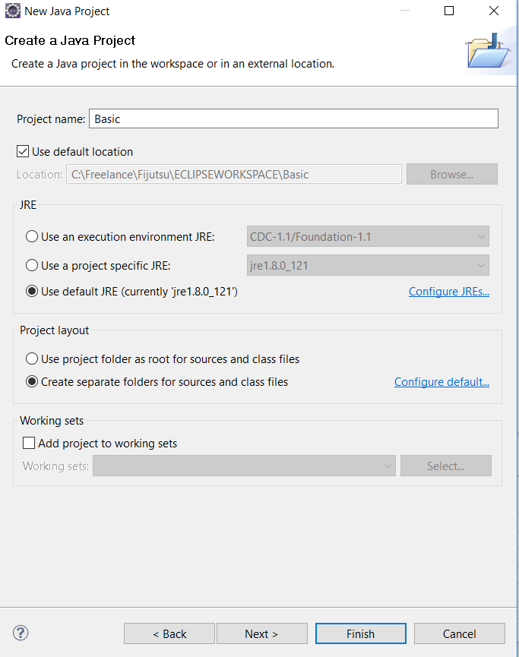
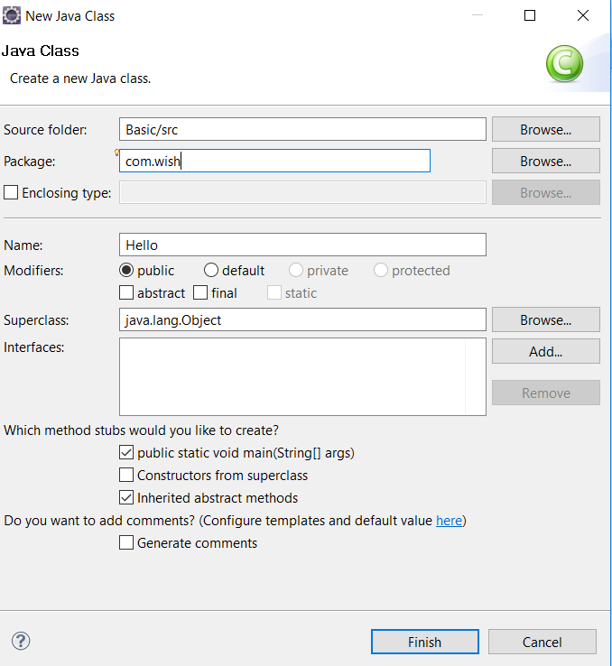
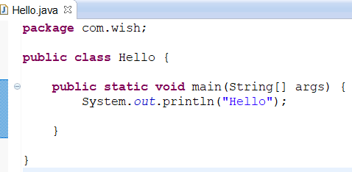
Lab : Create Hello Java
Open Eclipse
Create a new Java Project
Create Hello class.

Slide 57
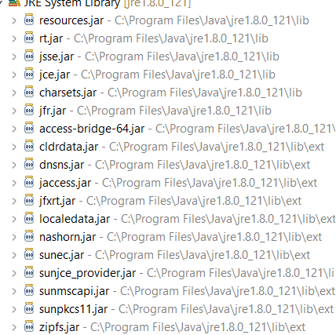
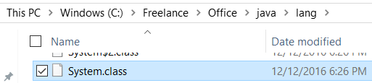
Analyze your program
Expand JRE node
Explain System class in java.lang
Explore Java.lang in rt.jar
Extract rt.jar
Run cmd as admin.
C:\Freelance\Office> jar xf C:\Progra~1\Java\jre1.8.0_121\lib\rt.jar
Go to target folder and check under java folder.

Slide 58
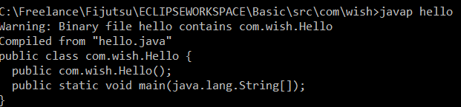
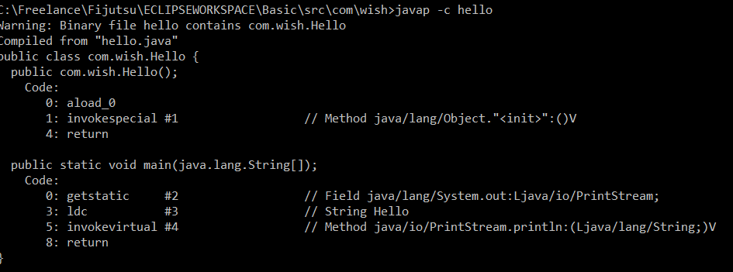
Decompile Hello.class
Javap <class filename>

Slide 59
Show bytecode Hello.class
Notes:
https://docs.oracle.com/cd/A97335_02/apps.102/a83727/jtools5.htm

Slide 60
Control Statement
Decision Making Statements
Simple if statement
if-else statement
Nested if statement
Switch statement
Looping statements
While
Do-while
For
For-Each
Branching statements
Break
Continue

Slide 61
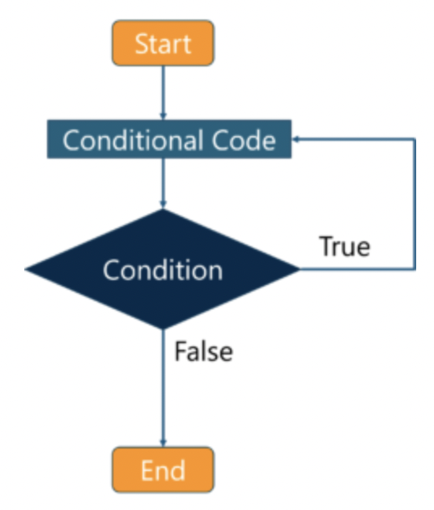
Control Statement
Control Statements can be divided into three categories, namely
Selection statements
Iteration statements
Jump statements

Slide 62
Control Statement -If-Else
public class Main
{
public static void main(String args[])
{
int a = 15;
if (a > 20)
System.out.println("a is greater than 10");
else
System.out.println("a is less than 10");
System.out.println("Hello World!");
}
}
}

Slide 63
Control Statement –Nested If
if (condition1) {
Statement 1; //executed if first condition is true
if (condition2) {
Statement 2; //executed if second condition is true
}
else {
Statement 3; //executed if second condition is false
}
}
public class Main
{
public static void main(String args[])
{
int s = 18;
if (s > 10)
{
if (s%2==0)
System.out.println("s is an even number and greater than 10!");
else
System.out.println("s is a odd number and greater than 10!");
}
else
{
System.out.println("s is less than 10");
}
System.out.println("Hello World!");
}
}

Slide 64
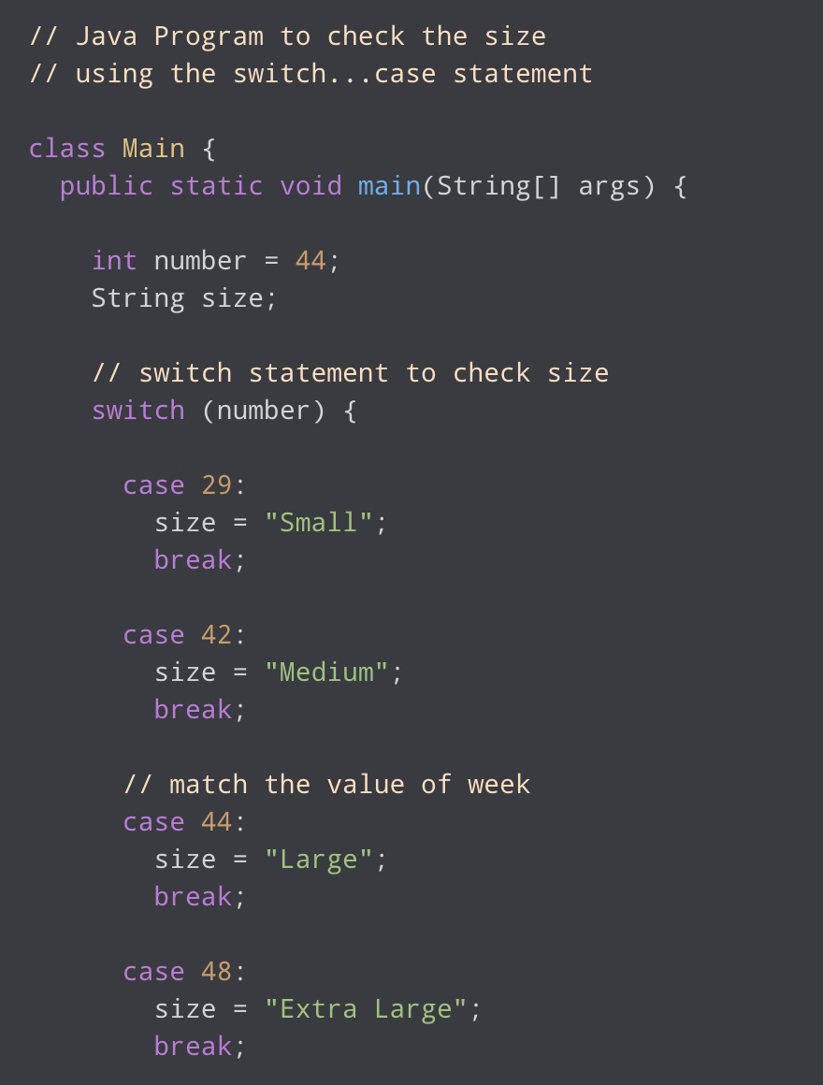
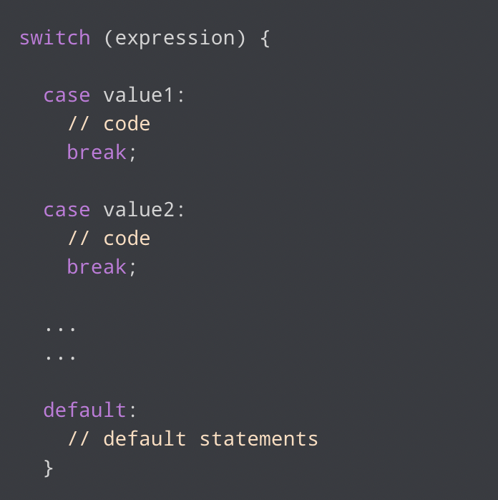
Control Statement -Switch
The switch statement allows us to execute a block of code among many alternatives

Slide 65
Control Statement - Loop
for loop
while loop
do...while loop

Slide 66
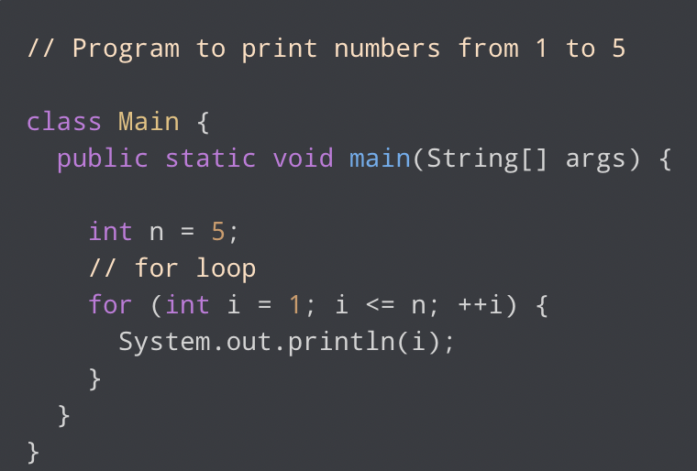
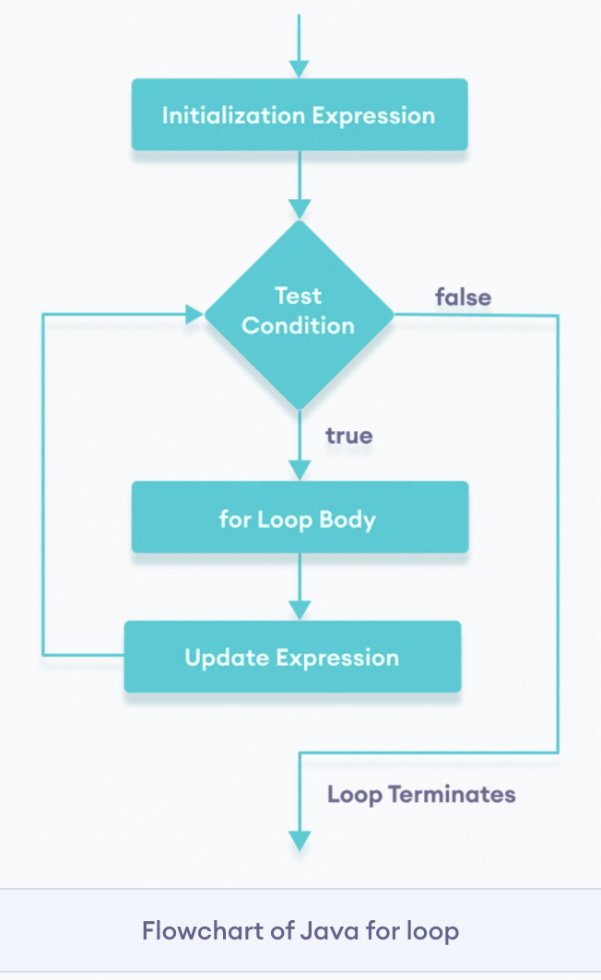
For Loop

Slide 67
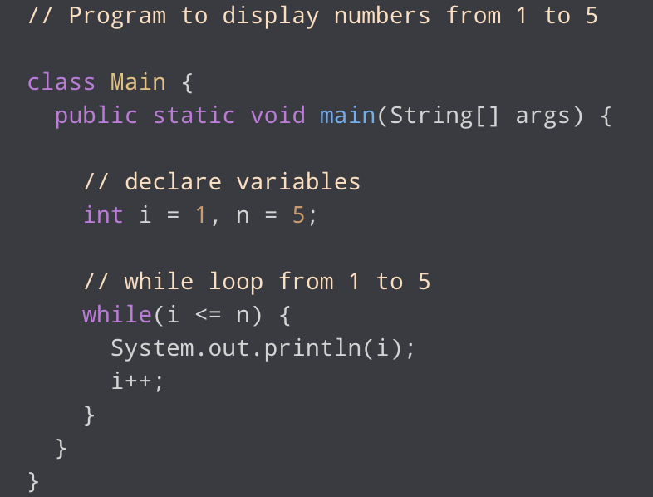
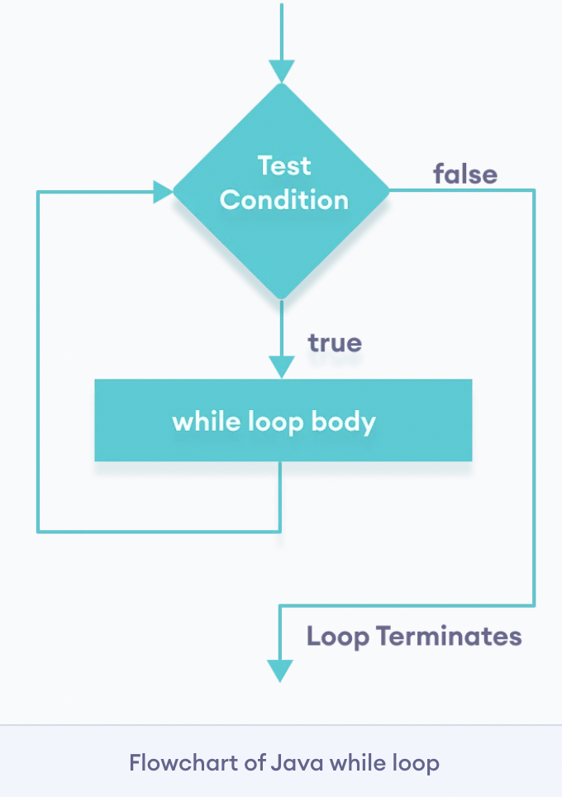
While Loop

Slide 68
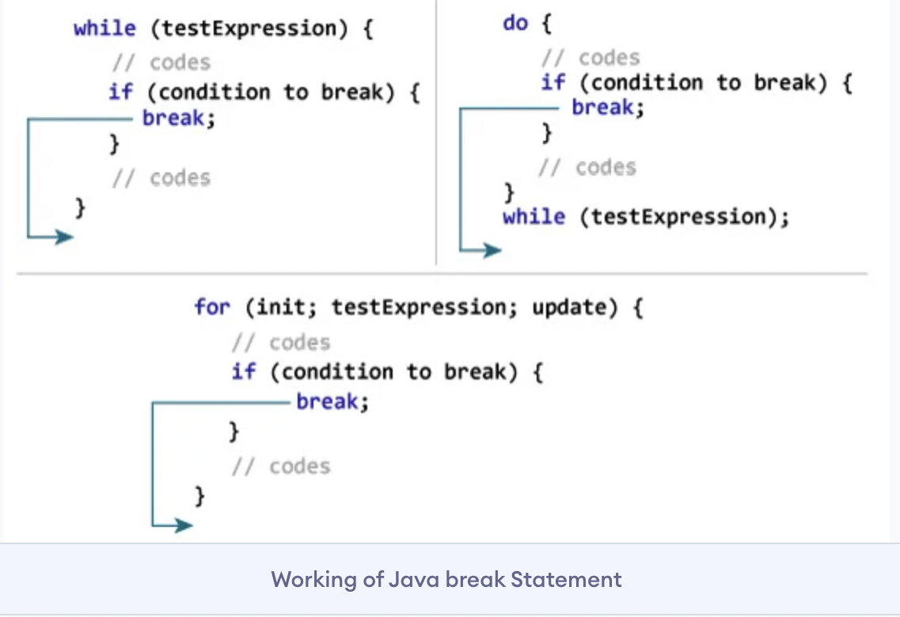
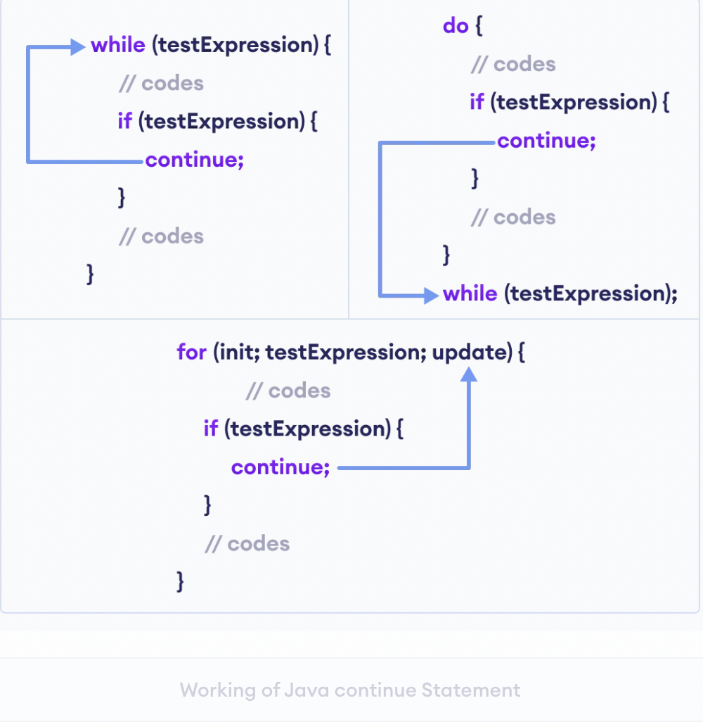
break

Slide 69
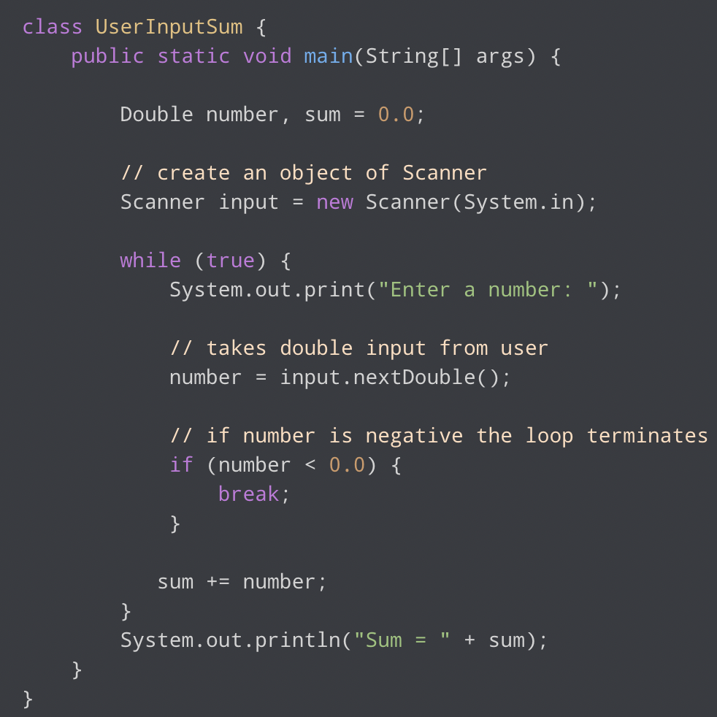

break

Slide 70

Continue
The continue statement skips the current iteration of a loop (for, while, do...while, etc).
After the continue statement, the program moves to the end of the loop. And, test expression is evaluated (update statement is evaluated in case of the for loop).

Slide 71

Stack and Heap
STACK
The stack section mostly contains methods, local variable, and reference variables.
A stack is a special area of computer's memory which stores temporary variables created by a function.
HEAP
1. It stores objects and Java Runtime Environment (JRE) classes.

Slide 72

Stack and Heap

Slide 73
Git
Git is an Open Source Distributed Version Control System. Now that’s a lot of words to define Git.

Slide 74
GIT
Control System: This basically means that Git is a content tracker. So Git can be used to store content — it is mostly used to store code due to the other features it provides.
Version Control System: The code which is stored in Git keeps changing as more code is added. Also, many developers can add code in parallel. So Version Control System helps in handling this by maintaining a history of what changes have happened. Also, Git provides features like branches and merges, which I will be covering later.
Distributed Version Control System: Git has a remote repository which is stored in a server and a local repository which is stored in the computer of each developer. This means that the code is not just stored in a central server, but the full copy of the code is present in all the developers’ computers. Git is a Distributed Version Control System since the code is present in every developer’s computer.

Slide 75

GIT Architecture

Slide 76
GIT Commands
git init: This Git command converts a directory into an empty repository. This is the initial step you need to take to build a repository. Once you run git init, you will be able to add and commit files and directories.
git add: This command allows you to add files in the Git staging area. The file must be added to the index of Git before being available to commit to any particular repository. You can use this command to add directories, files, etc.
git commit: The commit command in Git allows you to track the changes in the files in a local repository. Each commit has its own unique ID for reference.
git status: The git status command returns the present state of a repository, like if the file is in the staging area but has not been committed.
git branch: This command determines the branch of the local repository and allows you to add or delete a branch.
git checkout: You can use this command to switch to another branch.
git merge: The merge command allows you to integrate two or more branches together. It combines the changes made in the branches.

Slide 77
GIT Commands
git remote: This Git command allows you to connect a remote repository to a local repository.
git clone: You can use the clone command to create a local copy of an already existing remote repository. This allows you to copy and download the required repository to the system. It is similar to the init command while working with remote repositories as it allows you to build a local directory, consisting of all the necessary files and history of the repository.
git pull: The pull command is used to run the latest version of any repository. This pulls all the changes made from the remote to the local repository.
git push: This command sends local commits to the respective remote repository. It needs two parameters, i.e., the remote repository and the specific branch where it needs to be pushed.

Slide 78

Notes:
X`

